Slide 1

Click on the link in the slides below to see our live functioning products.
Our investment products are:
Insula Investment Funds, Insula Cryptocurrency, Insula Cryptocurrency Decentralized Exchange.
Our support service is:
Insula Premium subscription.

Slide 2
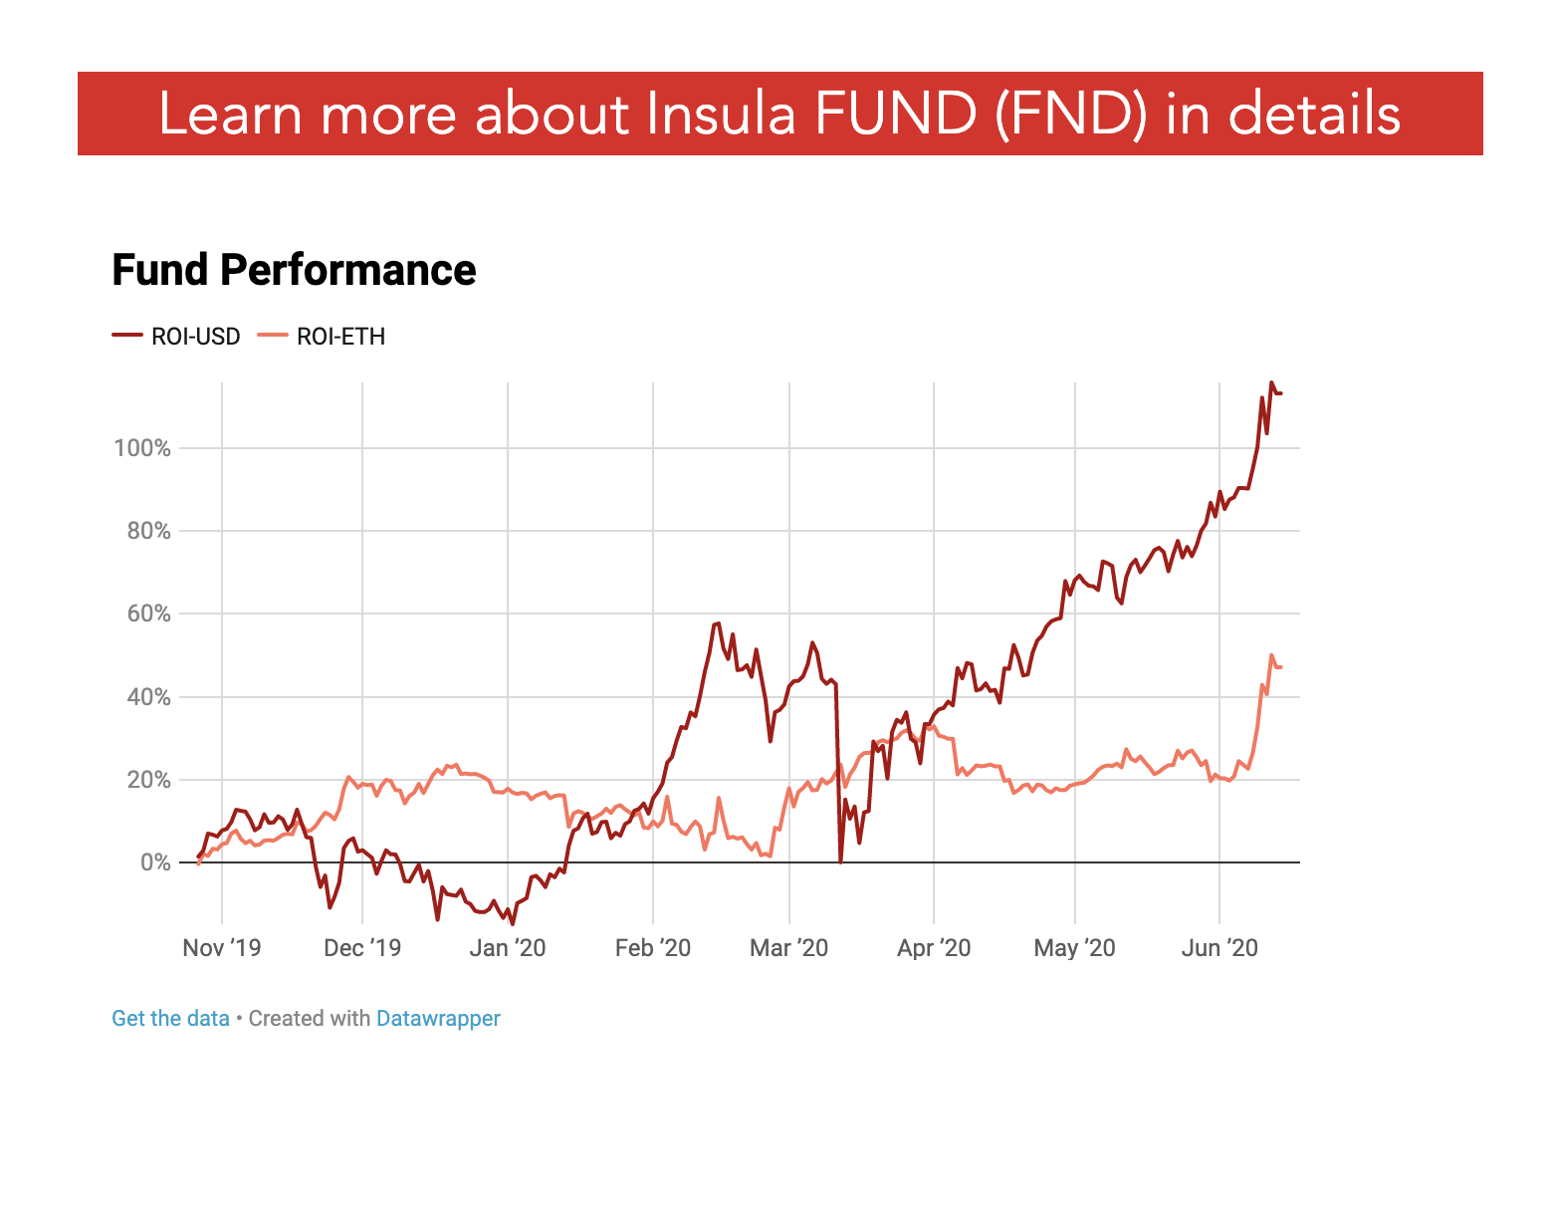
Insula investment funds
Click on the link below to discover Insula Investment Funds.
(Investment Funds tab)
https://insulainvestments.com/investment/
Insula Investment Funds
Insula Cryptocurrency
Insula Decentralized Exchange
Insula Investment Services

Slide 3
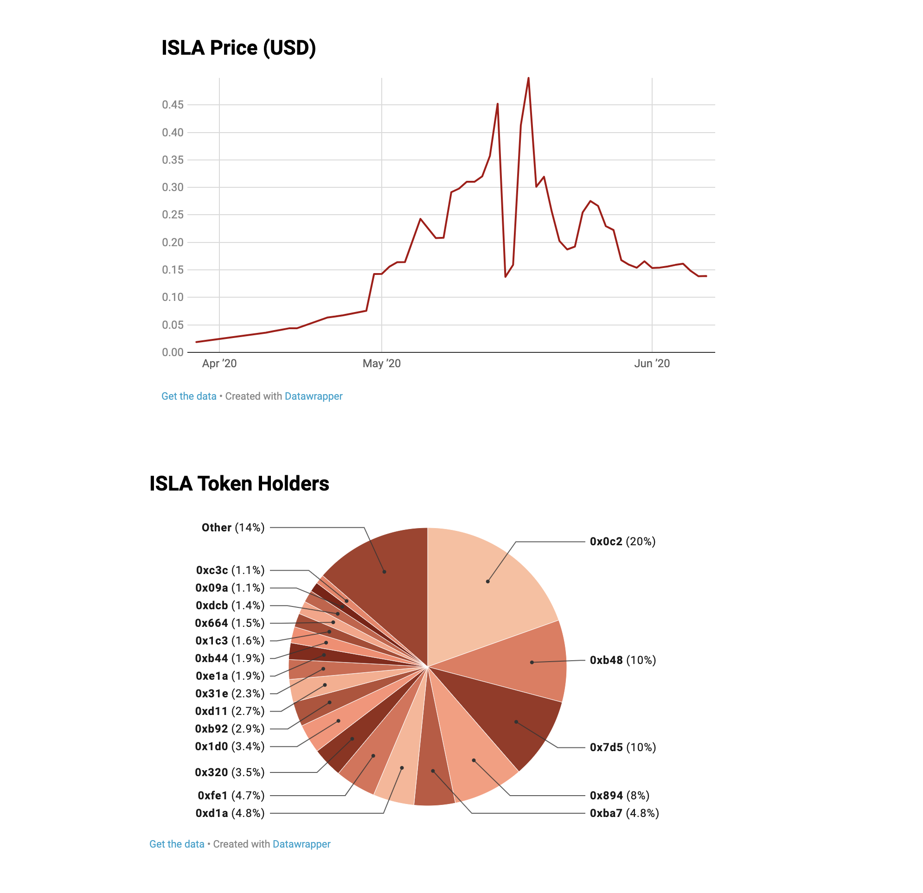
Insula CRYPTOCURRENCY
Click on the link below to discover Insula Cryptocurrency (ISLA)’s holders and price.
(Cryptocurrency & Banking tab)
https://insulainvestments.com/investment/
Insula Investment Funds
Insula Cryptocurrency
Insula Decentralized Exchange
Insula Investment Services

Slide 4
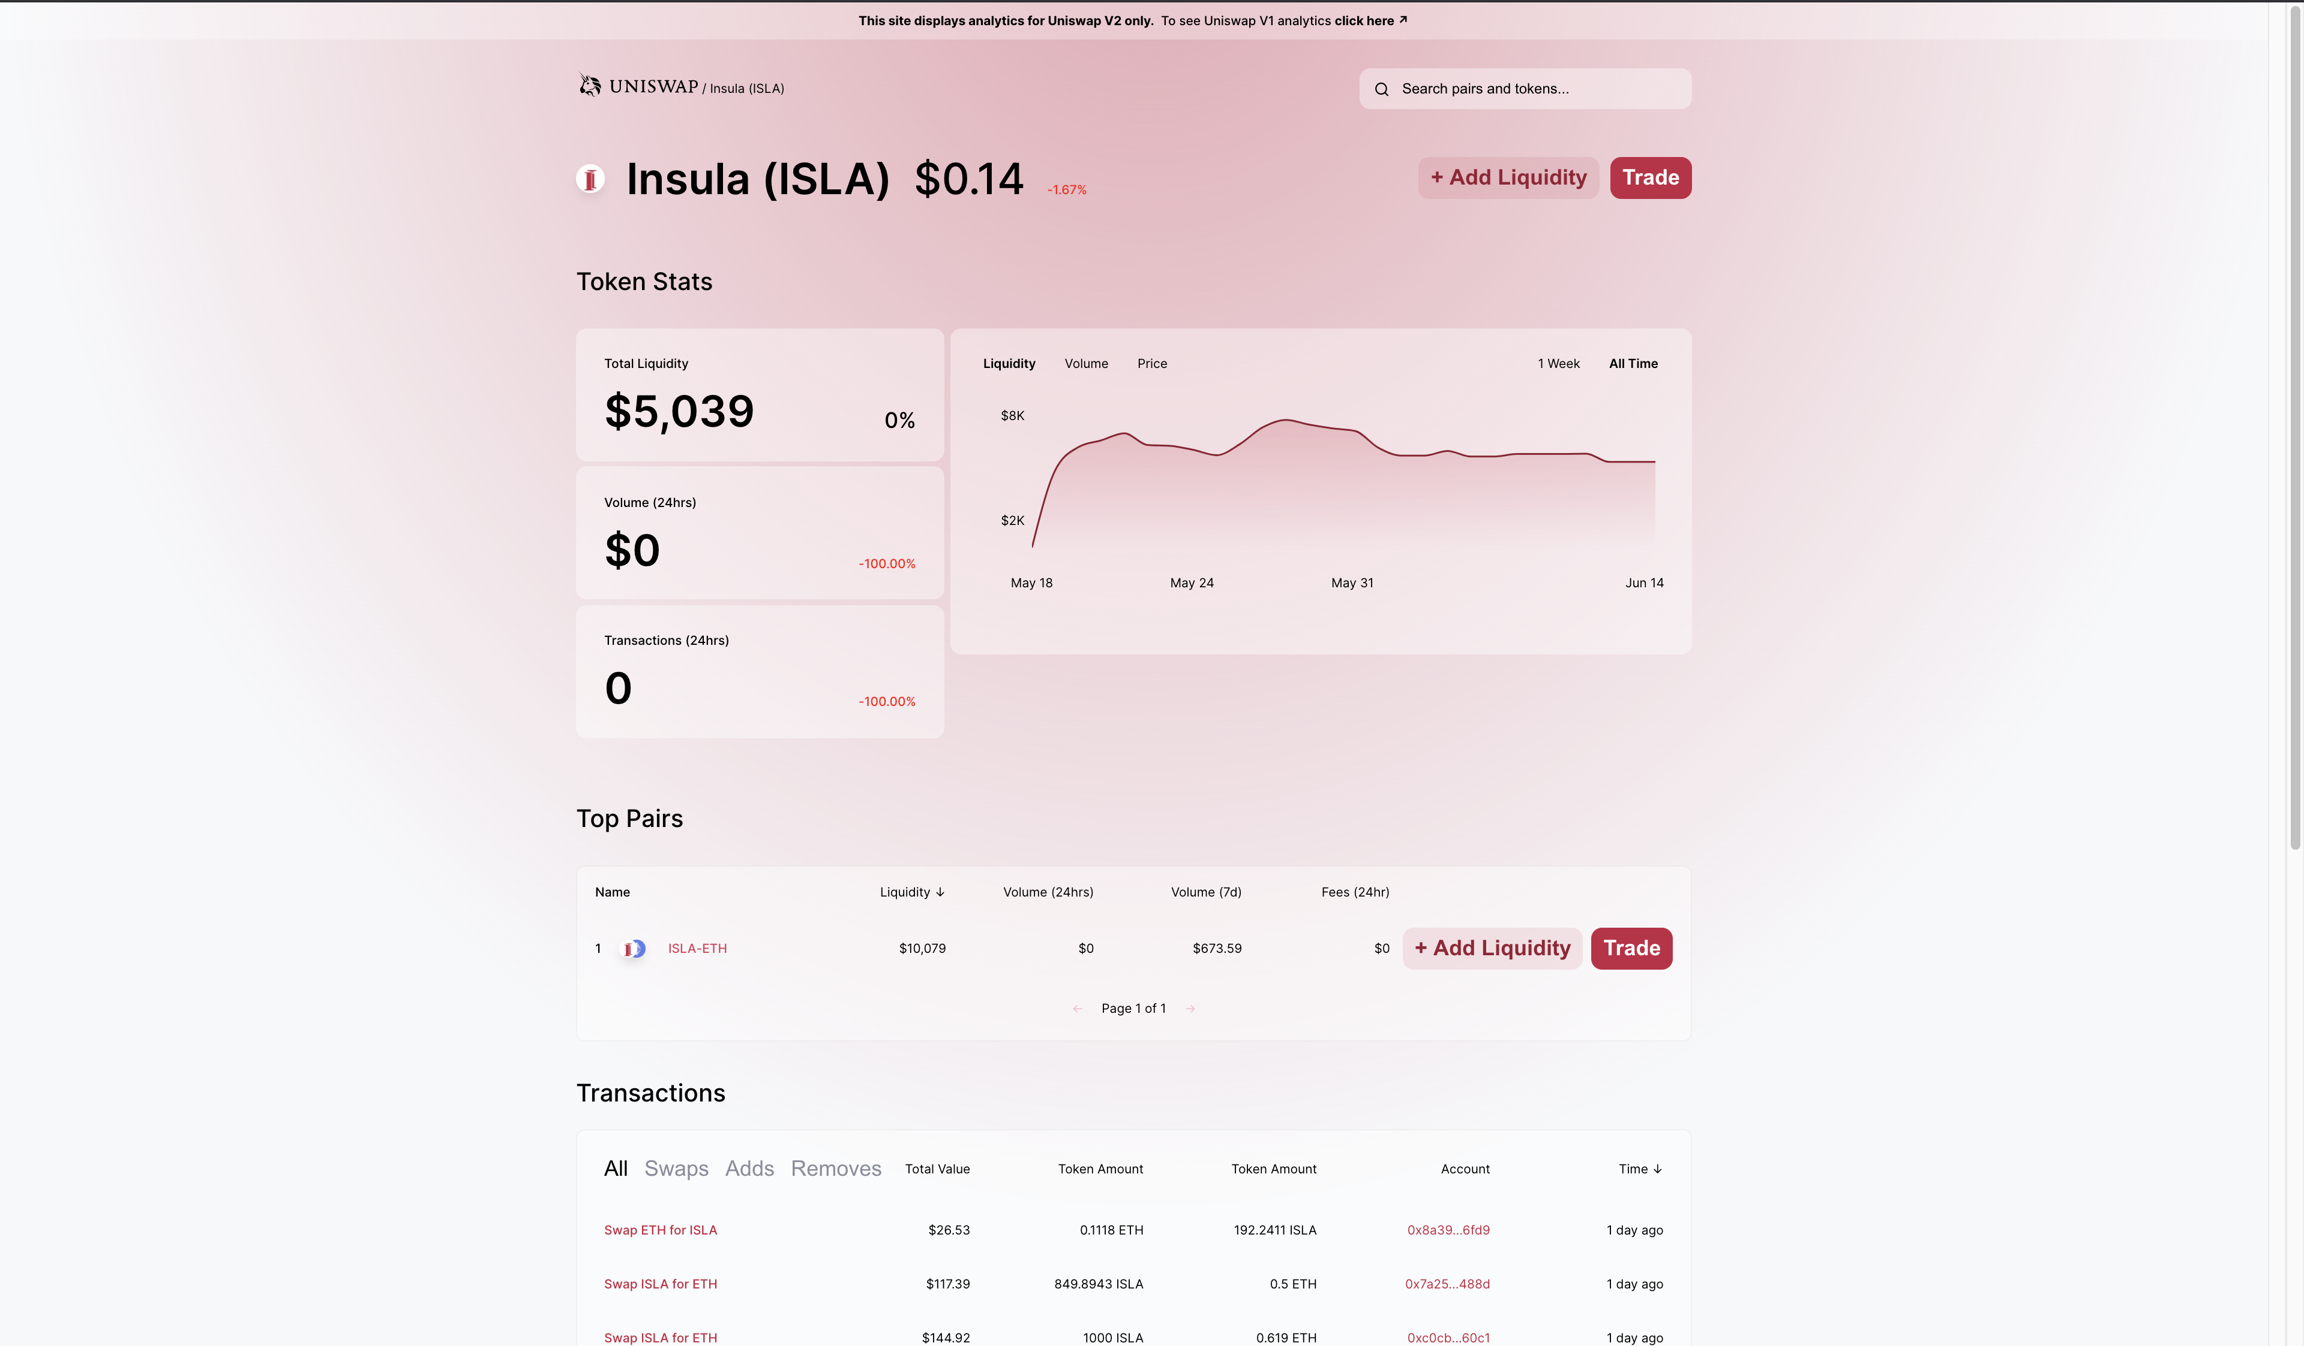
Insula DECENTRALIZED EXCHANGE
Click on the link below to discover Insula Decentralized Exchange.
https://uniswap.info/token/0x697ef32b4a3f5a4c39de1cb7563f24ca7bfc5947
Insula Investment Funds
Insula Cryptocurrency
Insula Decentralized Exchange
Insula Investment Services

Slide 5
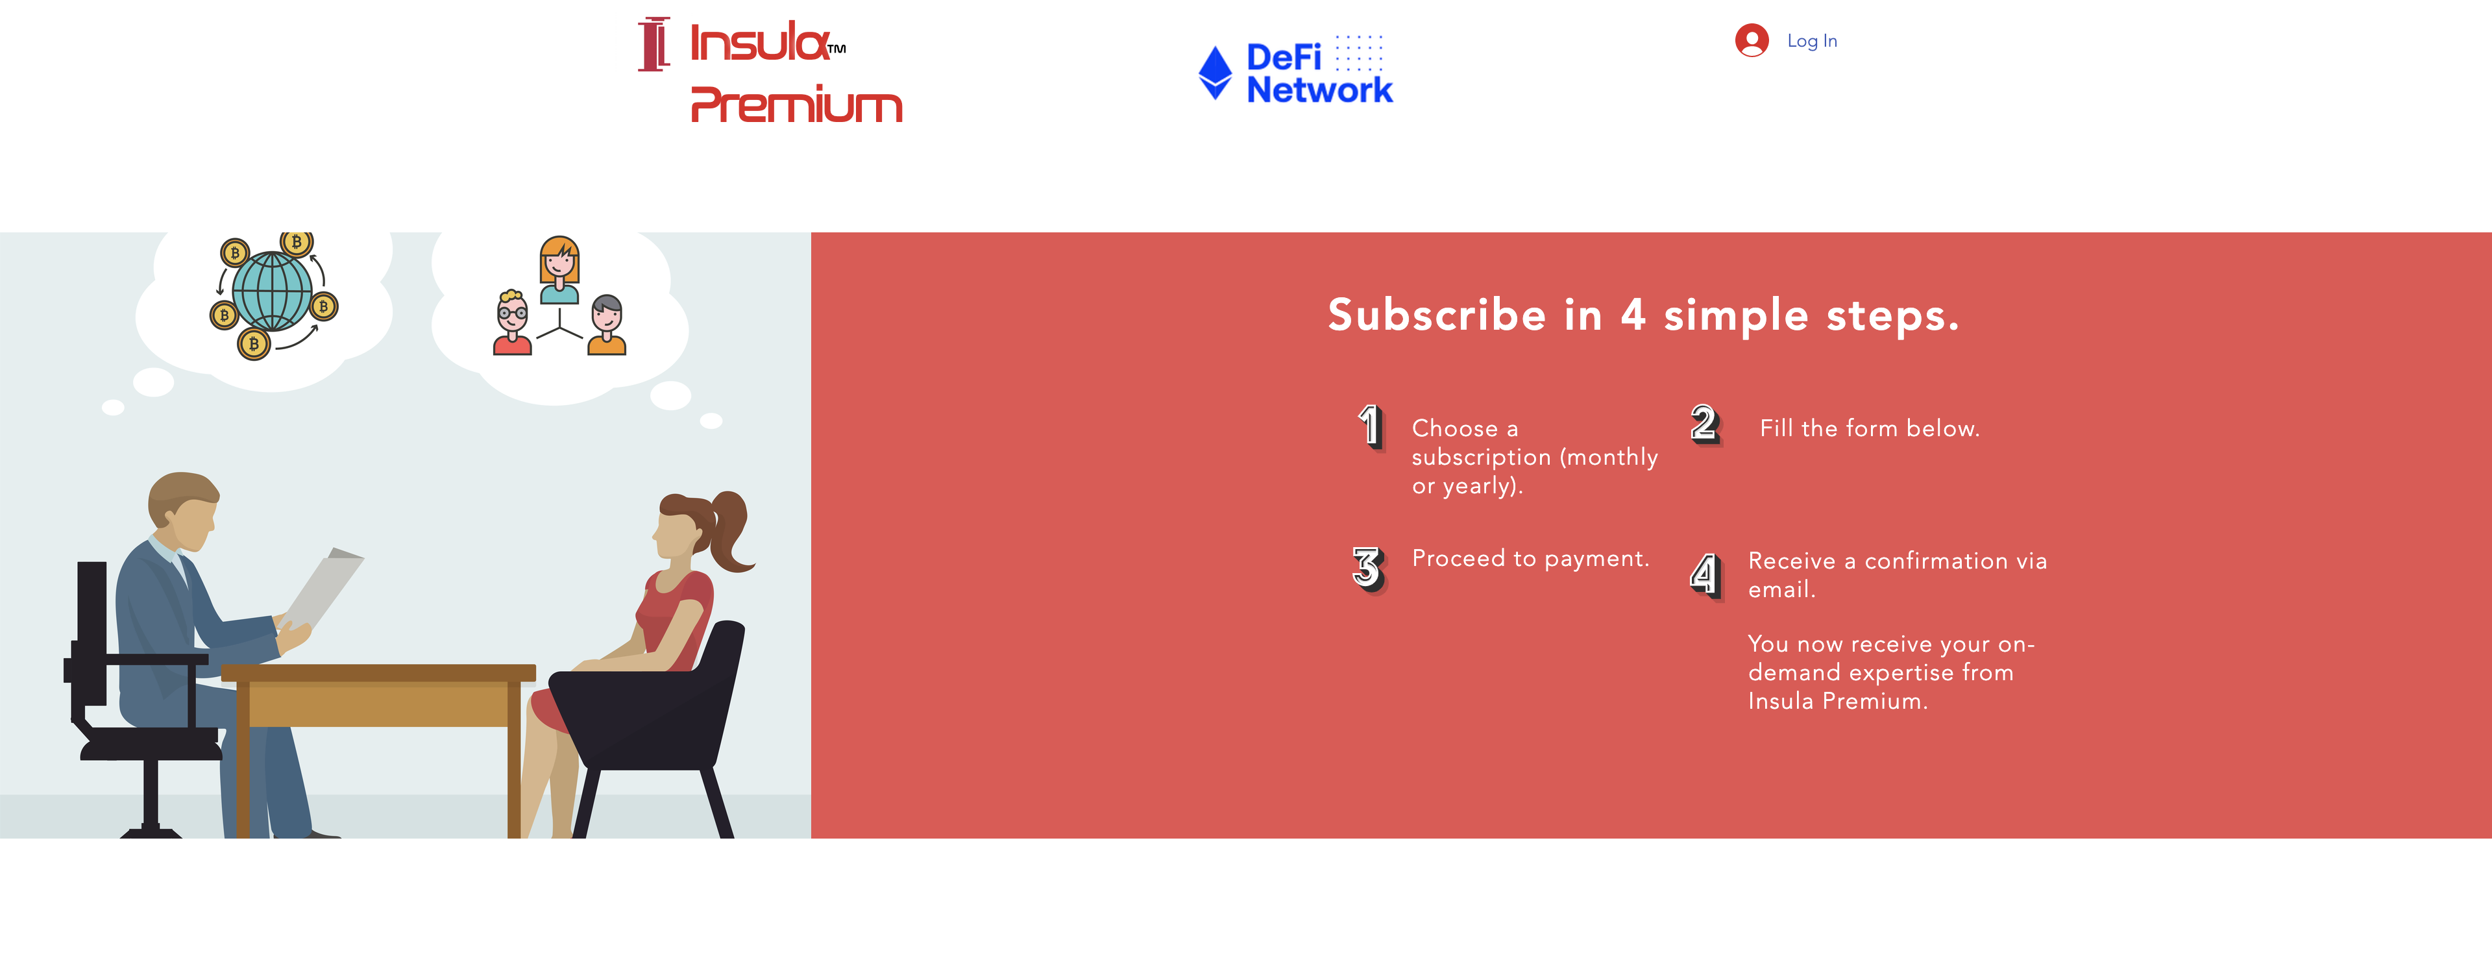
Insula PREMIUM SUBSCRIPTION
Click on the link below to discover Insula Premium subscription.
https://www.insulainvestments.co.uk/investment-consulting
Insula Investment Funds
Insula Cryptocurrency
Insula Decentralized Exchange
Insula Investment Services

